Slide 1

Unit 2
To be going to

Slide 2


To be going to
We use ‘to be’ going to to say that you are going to do something in the future
‘to be’ going to = gaan doen / worden

Slide 3


To be going to +
Subject + ‘to be’ + going to + verb
Examples:
I am going to go to school tomorrow.
She is going to have a baby.
We are going to meet next Saturday.

Slide 4


To be going to -
Subject + ‘to be’ + not going to + verb
Examples:
I’m not going to visit my grandparents.
He isn’t going to pay attention.
You aren’t going to speak.

Slide 5

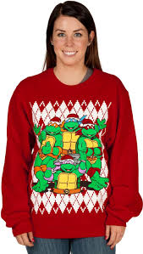
To be going to ?
‘to be’ + subject + going to + verb
Examples:
Am I going to read that new book?
Is Jill going to wear that sweater?
Are we going to visit our uncle this weekend?

Slide 6
Extra practice
http://www.ego4u.com/en/cram-up/grammar/future-1-going-to/exercises?04
http://www.ego4u.com/en/cram-up/grammar/future-1-going-to/exercises?05
http://www.ego4u.com/en/cram-up/grammar/future-1-going-to/exercises

